Slide 1
The Present and Future of Personalized Recommendations

Slide 2

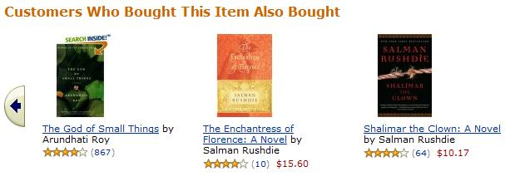
Personalized Retail

Slide 3
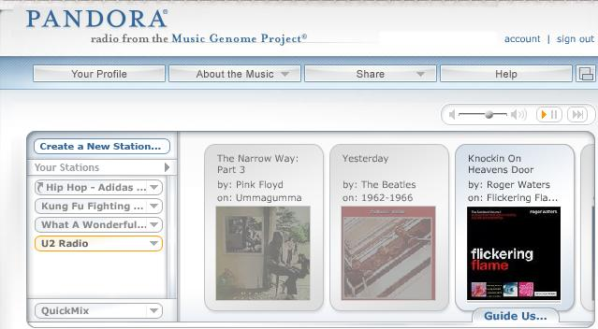
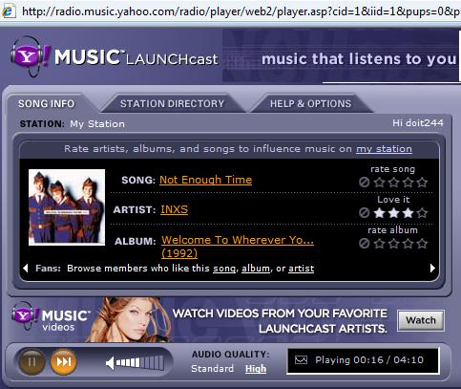
Personalized Radio

Slide 4
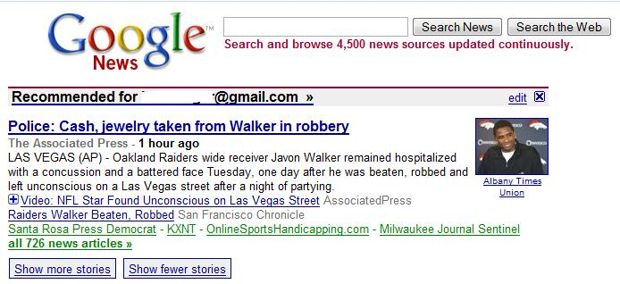
Personalized News

Slide 5
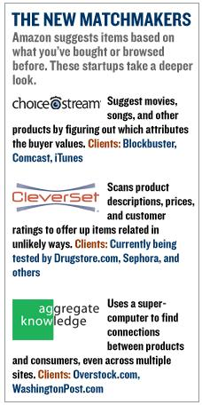
3rd Party Providers
Img Src: Business 2.0

Slide 6
Why are Recommenders Important?
Recommenders can be beneficial to both consumers and firms.
Value to Consumers: |  | • Learn about new products • Sort through myriad choices
Value to Firms: |  | • Convert browser to buyers • Cross-sell • Increase loyalty
Used by major Internet firms (Amazon, NetFlix, Yahoo!)

Slide 7
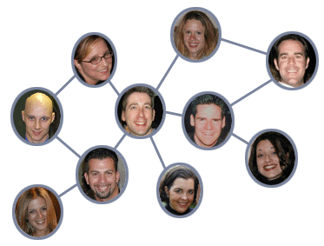
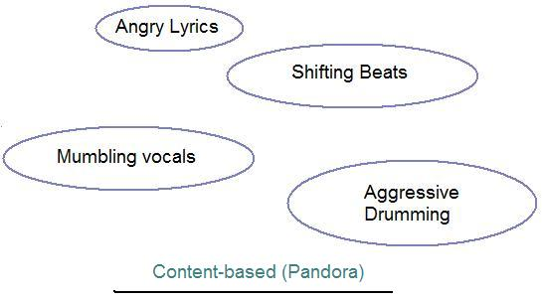


Recommender Design
Content Based | Collaborative | Social Network
Correlation Engine
Recommendations
vs.
High
Correlation

Slide 8
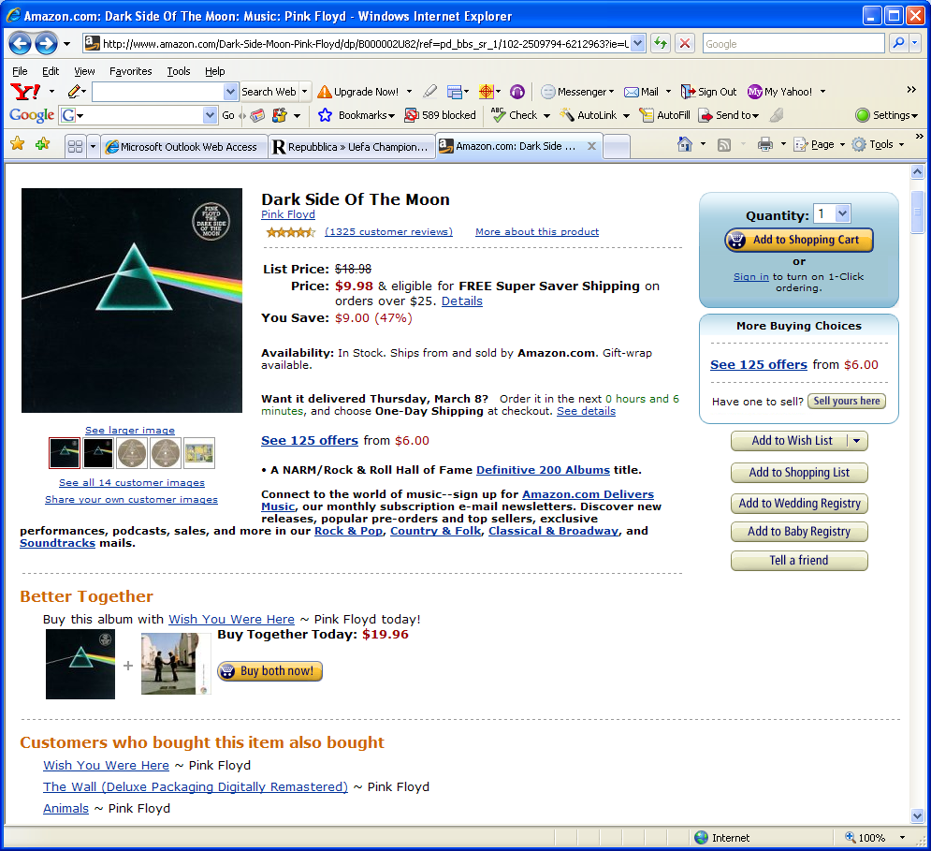
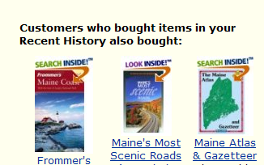
The Amazon Approach
Amazon uses all available information about customers in order to present the most relevant offer possible.
1
Customer views an item
Amazon immediately identifies his profile and recent history, the product attributes and the behavior of similar customers
2
A bundle is created based on the look-alikes
3
Additional items are proposed, based on other customers’ buying behavior

Slide 9
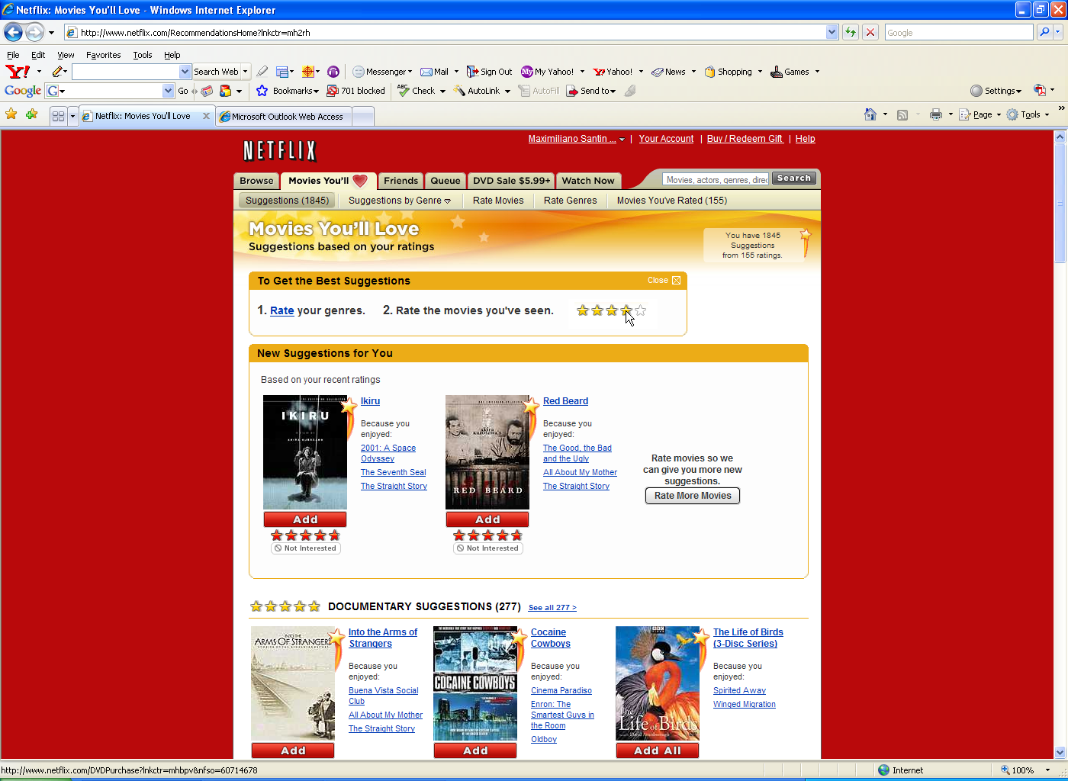
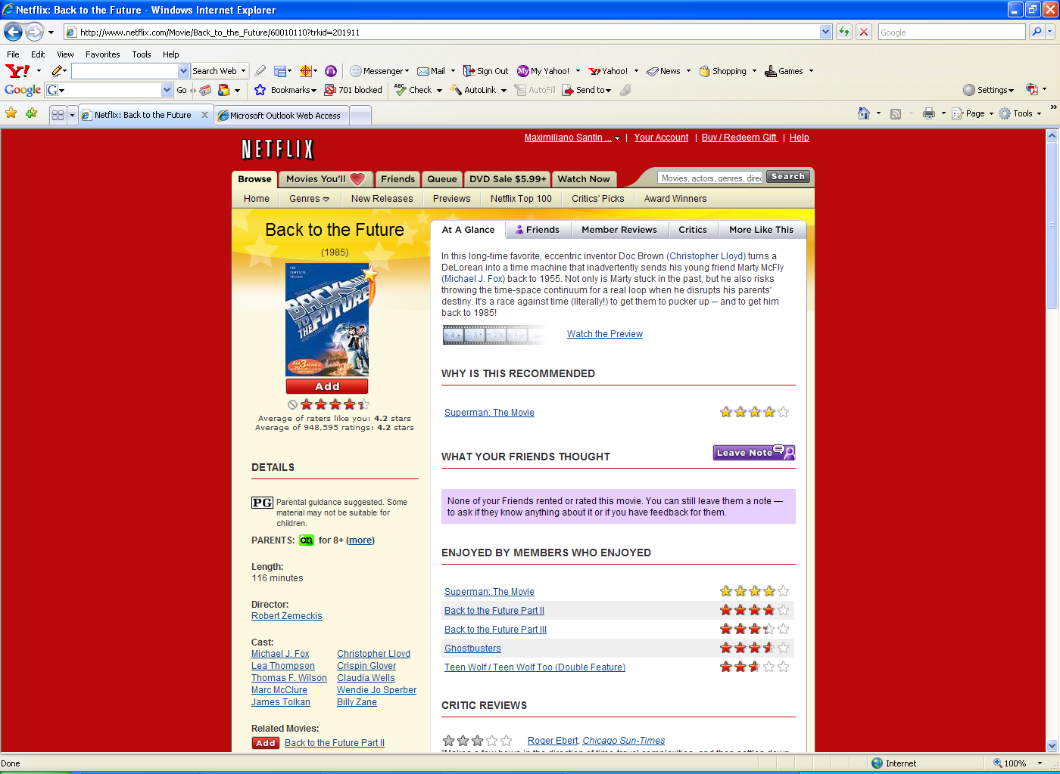
The Netflix Approach
Utilizing customer information, Netflix is able to improve profits through its recommendation engine.
Based on the “persona”, a group of movies the Customer will probably like is created
1
Customer asked to rate movies
Movie ratings are used by Netflix to build the customer “persona”
2
Based on the ratings provided by customer with a similar “persona”
3
A movie is then recommended
4

Slide 10
Cinematch Engine
Cinematch uses statistical techniques to identify similar users and recommend movies based on ratings of similar users.
Dataset
Correlation Engine
Recommendations
100 Million
18,000
Movies
vs.
User Ratings
High
Correlation
Encourage users to rate movies
Determine correlations in user ratings to identify similar users
Recommend movies based on evaluations of similar people
NetFlix Data Available (NetFlix Challenge)
Notes:
To overcome these challenges, Opera Solutions has developed a data-driven procurement solution that improves all key elements of corporate procurement.
Opera Solutions offers the only web-based software that quickly and repeatedly reveals hidden spending patterns to drive high-impact savings and procurement initiatives. ExpenseMap automates the aggregation, analysis, and categorization of millions of pieces of raw spending data and key supplier information from disparate internal and external sources – including AP, GL, ERP, purchasing card, wire transfer, and e-procurement systems.
We transform information into powerful intelligence that improves supplier management, sourcing, contract management, procurement (purchasing card, e-procurement, etc.), and change management initiatives – be it Opera Solutions' or other company’s offerings. Opera Solutions offers a packaged set of specialized software, training, services to support these types of initiatives, which makes our offering extremely complementary to all other solutions.
So companies gain greater compliance, deeper visibility on company-wide spending, and more optimal (‘on-contract’) spending.

Slide 11
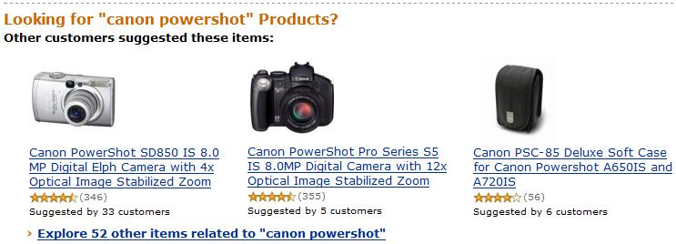
Recommender Impact: Substitution or Incremental Sales?

Slide 12
Impact on Volume (Fleder & Hosanagar 2007)
Results available in popular press(Billboard, Yahoo)

Slide 13
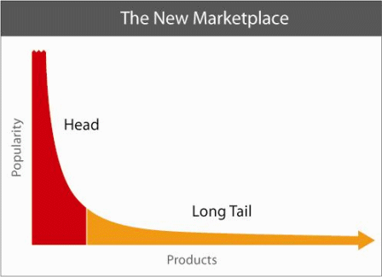
Recommenders => Long Tail? (Fleder & Hosanagar 2008)
Do recommenders (collaborative filters) foster discovery of obscure/niche items?

Slide 14
Results
Collaborative filters can help enhance sales diversity (e.g., by increasing awareness) but … a design feature, namely the use of sales data to recommend products, can often come in the way and drive up sales concentration
Notes:
Ratings, reviews influence choice; Long tail

Slide 15
Consumer level effects
Individual diversity can increase but aggregate diversity decreases
Basic design choices affect the outcome
How do you foster discovery?
Results available on web (SSRN)

Slide 16
Why do Recommenders Work? (Fleder & Hosanagar 2007)
Lots of biases in
What people watch
What people rate
Most systems assume ratings missing at random … yet they work. Why?
Test the impact of missing ratings

Slide 17
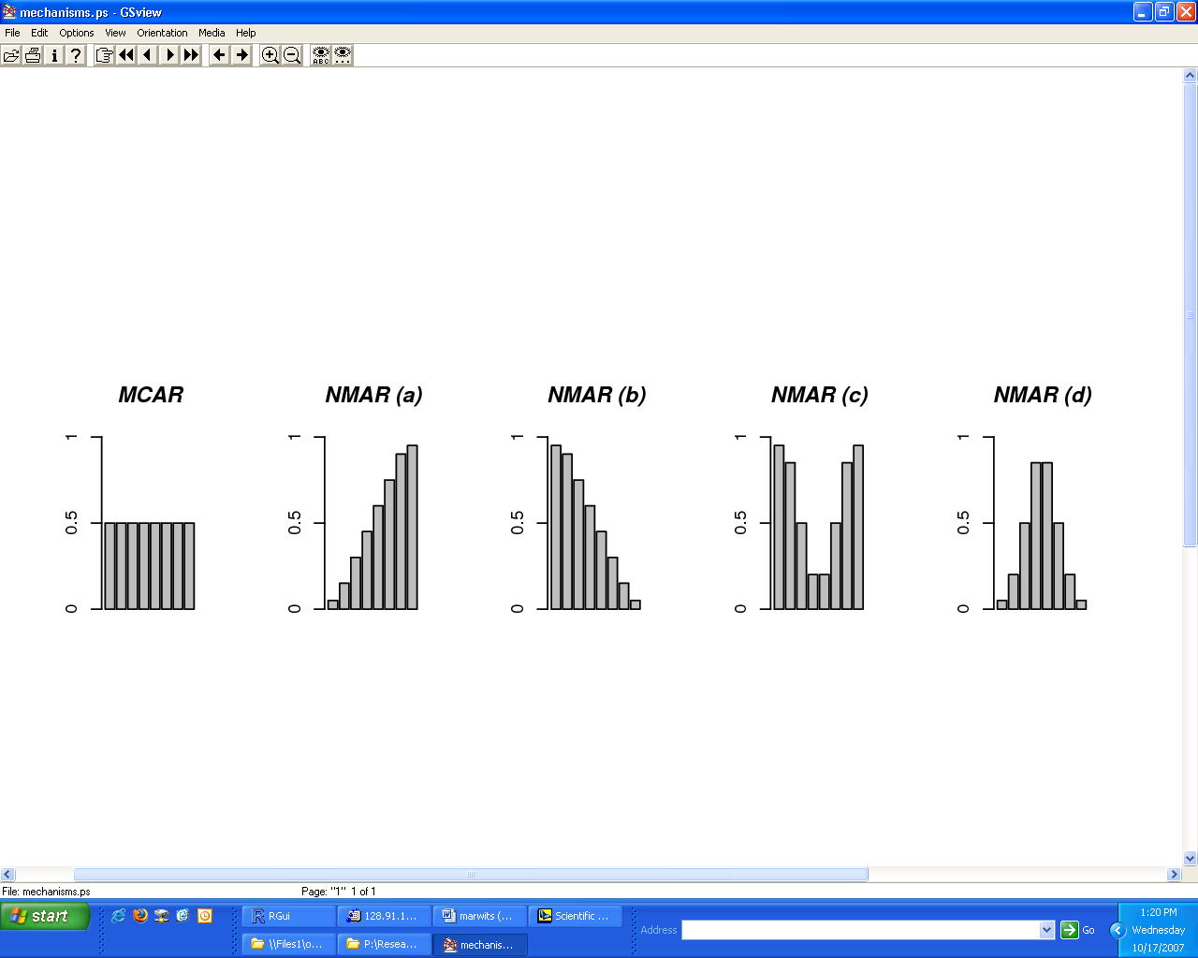
Results
 | Random | NR (a) | NR (b) | NR (c) | NR (d)
Chance missing | Equal | Increasing | Decreasing | U-Shape | Inverse-U
Prediction error (E) | 0.770 | 0.785 | 0.791 | 0.945 | 0.686

Slide 18
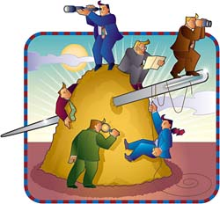
Future of Personalized Recommendations?
Discovery
Fluid inter-site personalization
Privacy
Ownership
Contact: kartikh@wharton.upenn.edu

